Slide 1
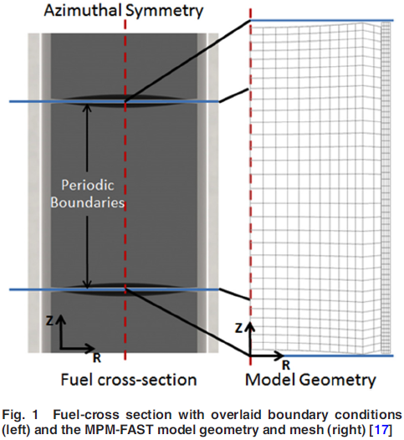
A Thoria and Thorium Uranium Dioxide Nuclear Fuel Performance Model Prototype and Knowledge Gap Assessment
NE591 Project
Instructor: Dr. Benjamin Beeler
Student: Fu-Yun Tsai

Slide 2
Outline
The purpose of this article
Background
SCWR
Thorium fuel
U-233 v.s U-235
Experiment
Modeling results
Centerline temperature
Fission gas release
Deformation
Future work

Slide 3
The purpose of this article
Th-232 is more abundant in nature than uranium and may provide better fuel sustainability in nuclear industry.
Royal Military College of Canada (RMCC) is working on developing and integrating ThO₂ and (Th,U)O₂ models into the existing FAST model led to the multipellet material FAST (MPM-FAST).
The fuel and sheath modeling tool (FAST), a fuel performance model for UO₂ fuel, was developed at the Royal Military College of Canada (RMCC).
FAST capability has been extended to include thoria (ThO₂), thorium uranium dioxide (Th,U)O₂, and thorium plutonium dioxide (Th,Pu)O₂ as fuel pellet materials, to aid in designing and performance assessment of Th-based fuels, including SCWR (Th,Pu)O₂ fuel.
This paper shows a comparison between modeling results with postirradiation examination (PIE) data from a test conducted at CNL, and an account of the knowledge gap between our ability to model ThO₂ and (Th,U)O₂ fuel compared to UO₂.
The Zircaloy-4 model (the sheath heat transport and deformation) within MPM-FAST was not modified from FAST.

Slide 4
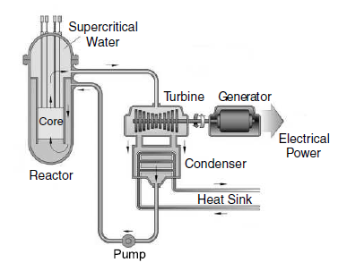
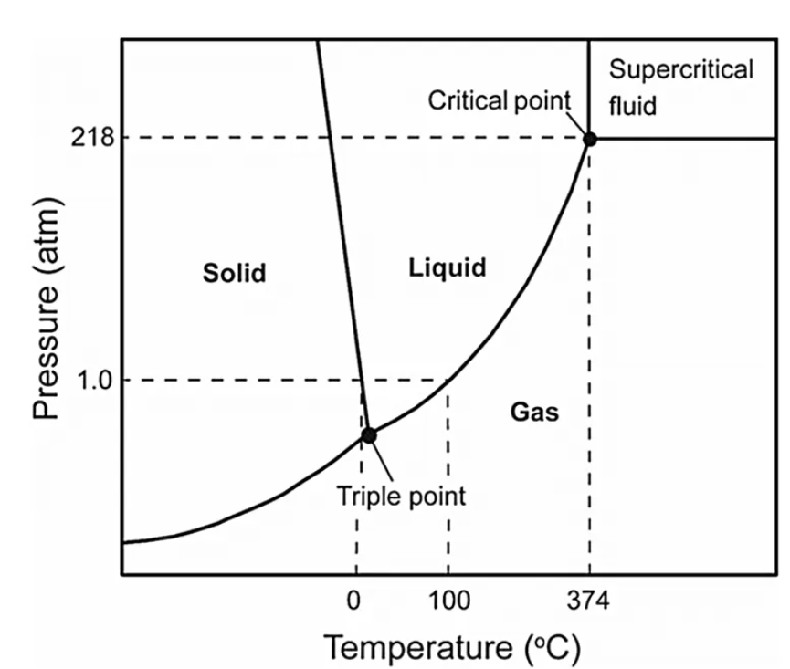
Supercritical Water-Cooled Reactor (SCWR)
High-temperature, high-pressure water-cooled reactors that operate above the thermodynamic critical point of water (374 ℃, 22.1 MPa).
No boiling crisis (i.e., departure from nucleate boiling or dry out) exists due to the lack of a second phase in the reactor.
The efficiency of a SCWR can approach 44%, compared to 33–35% for LWRs.
Steam dryers, steam separators, recirculation pumps, and steam generators are eliminated.
153 atm (15.51 Mpa)
Picture 1: J. Kenneth Shultis Richard E. Faw, Fundamental of Nuclear Science and Enigineering, 2017
Picture 2: https://www.sludgeprocessing.com/oxidative-thermochemical-treatment/supercritical-water-oxidation-scwo-sludge/
293~326 ℃

Slide 5

Thorium fuel
In the thorium cycle, fuel is formed when Th-232 captures a neutron to become Th-233. After two β⁻ decay, Th-232 is transmuted into the fissile, U-233.
Advantage:
Th-232 is four times more abundant in nature than uranium and spread evenly around the earth.
Thorium fuel doesn’t need complex and expensive enrichment processes. (Natural U: 0.7204% U-235, 0.0054% U-234 and 99.2742% U-238)
(Natural Th: 100% Th-232)
There is no nuclear fuel proliferation issues since the main isotopes created from thorium cycle are U-232 and U-233 were not easy to make nuclear weapons.
Comparing to UO₂, ThO₂ possesses superior thermal conductivity, thermal expansion, higher melting temperature, and oxidation resistance that may improve both fuel performance and safety.

Slide 6
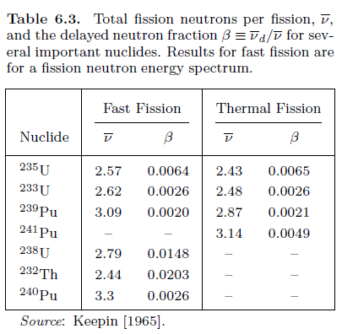
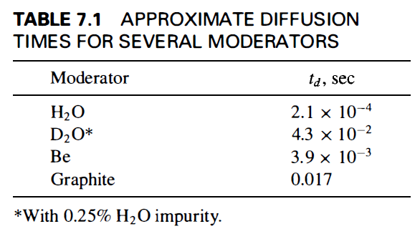
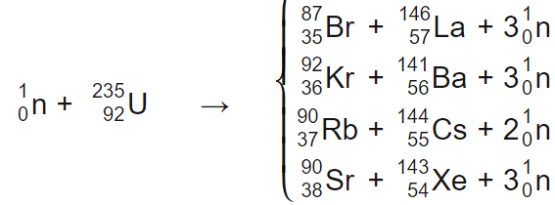
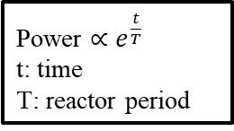
U-233 vs. U-235
Delayed neutron: A small fraction of fission neutrons are not emitted right after the fission event since they are produced by the neutron decay of fission.
Delayed neutron fraction=delayed neutron per fission/ total fission neutrons per fission.
The delayed neutrons considerably increase the reactor period. Therefore, reactors can be controlled rather easily.
Larger diffusion time of thermal neutron makes reactor control easier.
Power $∝e^{\frac{t}{T}}$
t: time
T: reactor period

Slide 7
Experiment
DME-221 is an experimental fuel irradiation test conducted by CNL (Canadian Nuclear Laboratories).
DME stands for “demountable element” which means how the experimental fuel is inserted into the test loops of the National Research Universal reactor.
In the case of DME-221, the bundle has the same geometry as a 37-element Canadian PHWR fuel bundle.
Six variations of experimental fuel were fabricated for DME-221.
 | ThO₂ | (Th,U)O₂ with 1.0wt% U-235 | (Th,U)O₂ with 1.5wt% U-235
L/D=1.3
L/D=0.7
NWMO TR-2013-070, Postclosure Safety Assessment of a Used Fuel Repository in Sedimentary Rock, 2013, p.111
L/D: the ratio of length-to-diameter in a fuel pellet

Slide 8
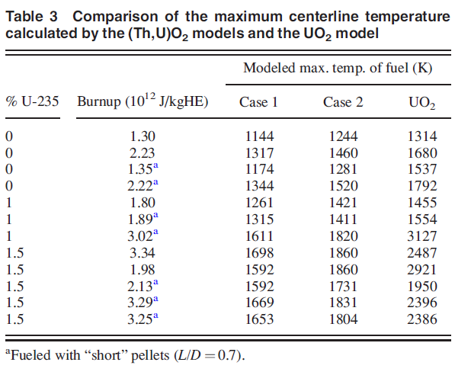
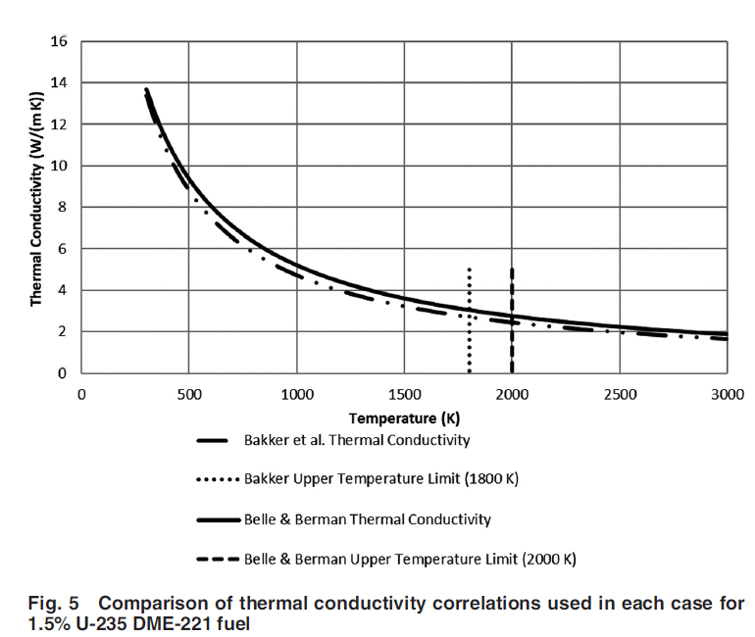
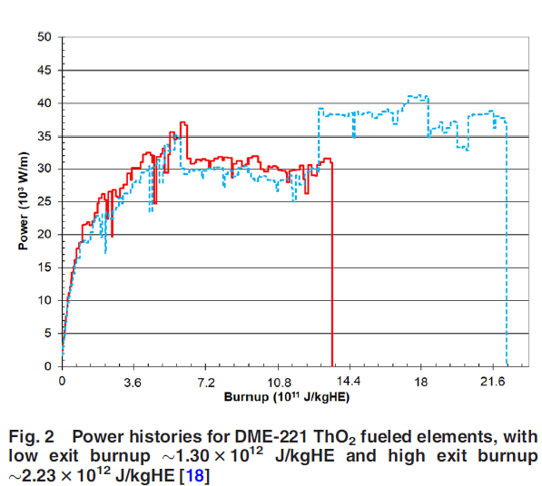
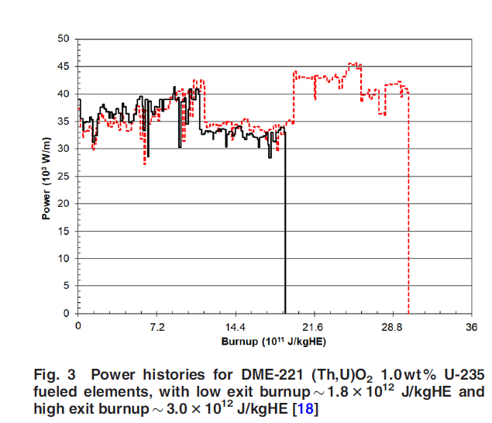
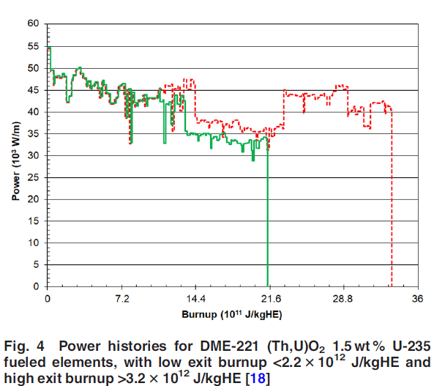
Modeling Results-(1) Centerline Temperature
Because DME-221 is not an instrumented fuel test, there are no fuel temperature measurements to validate the modeling results.
The Th-based fuel model using either the Belle and Berman correlation or the Bakker et al. thermal conductivity correlation consistently predicts lower centerline temperatures than the UO₂ model.
This temperature difference arises because the Bakker et al. model predicts lower thermal conductivity values compared to the Belle and Berman model.
ThO₂ based fuel
UO₂
MPM-FAST
FAST
Belle & Berman
Bakker
ThO₂
(Th,U)O₂ with 1.0wt% U-235
1800 K
(Th,U)O₂ with
1.5wt% U-235
2000 K
Power
(10³W/m)
Power
(10³W/m)
(Th,U)O₂ with 1.0wt% U-235
Power
(10³W/m)
ThO₂
(Th,U)O₂ with
1.5wt% U-235
Extrapolating data
Increasing Power
Constant Power
Decreasing Power
Burnup(10¹²J/kgHE)
Burnup(10¹²J/kgHE)
Burnup(10¹²J/kgHE)
Notes:
Consensus within the literature is in favor of using the Bakker correlation over the Belle and Berman correlation due to later measurements displaying larger degradation in thermal conductivity with uranium content than predicted by Belle and Berman.
It should be noted that many of the high burnup elements in case 2 exceed the maximum temperature for which the Bakker et al. conductivity correlation was developed. This leads to additional uncertainty in the temperature behavior for these cases because it is not known if extrapolating the Bakker correlation is representative in this regime.

Slide 9
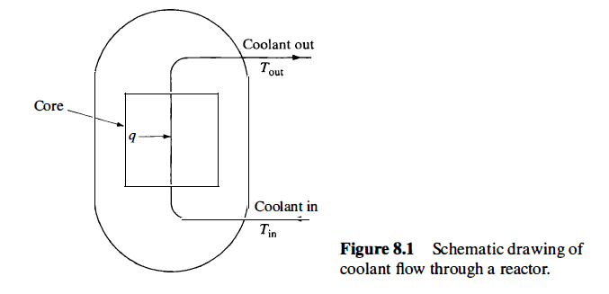
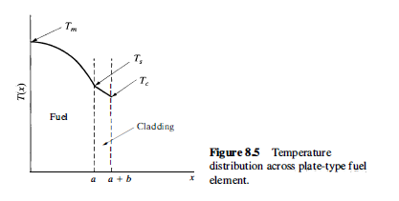

How the industry measure the centerline temperature of the fuel pellet?
Measure inlet temperature and outlet temperature.
From the above measured data, the heat produced in the reactor absorbed by the coolant can be calculated.
By using SIMULATE and CASMO codes, the hottest location can be known.
If the coolant temperature is known, the centerline temperature can be obtained by calculation.
John R. Lamarsh, Introduction to nuclear engineering 3rd edition, 2001, Chapter 8 Heat Removal from Nuclear Reactors, p.406, p.422

Slide 10
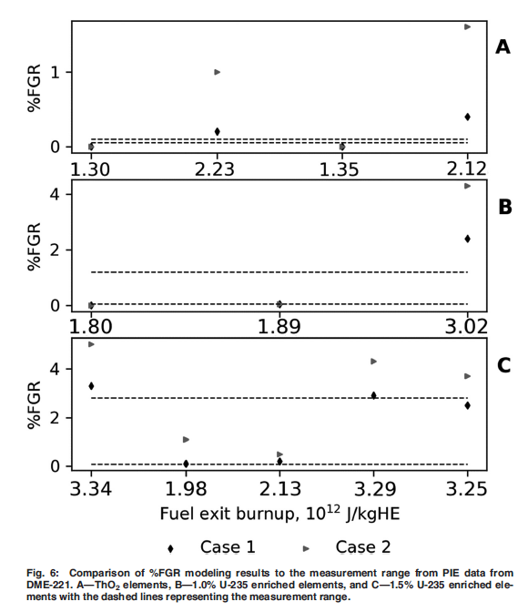
Modeling Results-(2) Fission Gas Release
It was found in CNL irradiation experiments that the observed FGR from Th-based fuels is significantly less than that observed in UO₂ fuel.
In the development and benchmarking of MPM-FAST, it is recommended that the Belle & Berman model be used, as it is better at reproducing the FGR behavior of the DME-221 experiment.
ThO₂
(Th,U)O₂ with 1.0wt% U-235
(Th,U)O₂ with
1.5wt% U-235
Belle & Berman
Bakker

Slide 11
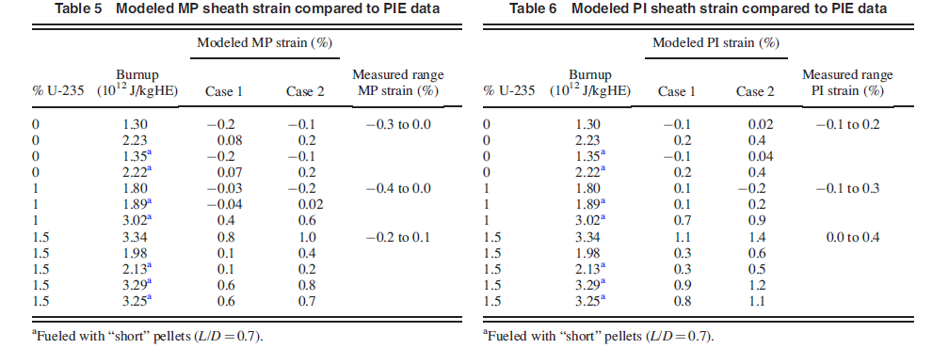
Modeling Results-(3) Deformation
The model begins to overpredict the end-of-life element strains beyond a systematic high temperature limit for each of the fuel compositions.
Overprediction of sheath strain may come from a significant number of the models for plastic deformation within the Th-based fuel pellet were adopted from the UO₂ model. An example of this is the gaseous swelling strain since the model is highly dependent on temperature.
PI
(pellet-to-pellet interface)
MD
(midpellet)
Belle & Berman
Bakker
Belle & Berman
Bakker

Slide 12
Future work
Irradiation model (Lucuta model) was developed for UO₂ fuel with simulated burnup, it remains to be demonstrated if it can apply to mixed thorium–uranium dioxide fuel.
Due to the limited axial change in flux and coolant temperature along the length of a 0.5 m fuel element, it is further assumed that the irradiation behavior of one pellet is representative of all pellets within a fuel element.
This height difference is representative of the free axial gap divided by the number of pellets in the stack. However, the approximation may not be conservative.
The version of FAST used in the development of MPM-FAST assumes axial symmetry of a cylindrical fuel element to reduce the model to two dimensions.
An additional source of error in fuel temperature may be arising from using a flux depression model that has been developed for UO₂.

Slide 13
Reference
J. S. Bell et al., A Thoria and Thorium Uranium Dioxide Nuclear Fuel Performance Model Prototype and Knowledge Gap Assessment, 2019, Journal of Nuclear Engineering and Radiation Science
J. Kenneth Shultis Richard E. Faw, Fundamental of Nuclear Science and Enigineering, 2017, Chapter 6 Binary Nuclear Reactions, p. 158 and Chapter 11 Generation Ⅳ Nuclear Reactor Design, p.396~398
Phase diagram for water https://www.sludgeprocessing.com/oxidative-thermochemical-treatment/supercritical-water-oxidation-scwo-sludge/
John R. Lamarsh, Introduction to nuclear engineering 3rd edition, 2001, Chapter 6 Nuclear Reactor Theory, p.287 and Chapter 7 The Time-Dependent Reactor, p.327~340, Chapter 8 Heat Removal from Nuclear Reactors, p.406, p.422
IAEA-TECDOC-1450, Thorium fuel cycle-Potential benefits and challenges, 2005, p.1~3, p.85~p.88
Corbett, S., Floyd, M. R., Livingstone, S. J., Hamilton, H., and Harrison, N. F., 2013, “DME-221 Thoria Fuel: Fabrication, Irradiation Testing, and Post- Irradiation Examination,” 12th International CANDU Fuel Conference Proceedings, Kingston, ON, Canada, Sept. 15–18, pp. 1–14.
NWMO TR-2013-070, Postclosure Safety Assessment of a Used Fuel Repository in Sedimentary Rock, 2013, p.111

Slide 14

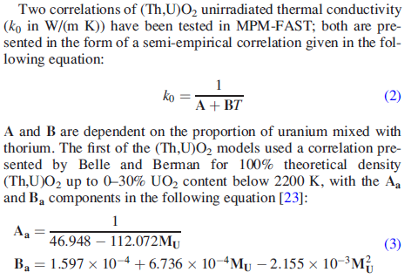
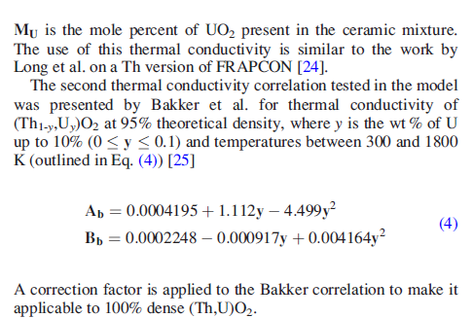
Heat Transport

Slide 15
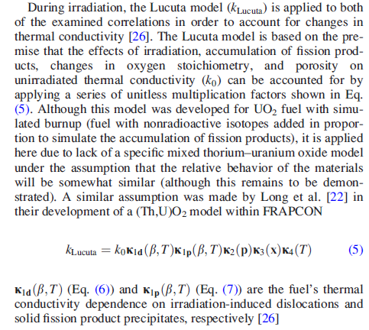
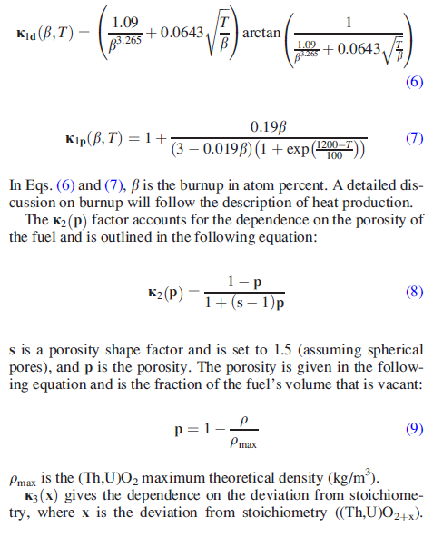
Heat Transport
irradiation-induced dislocations
solid fission product precipitates

Slide 16
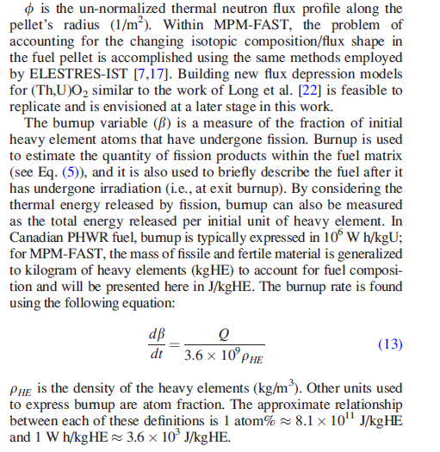
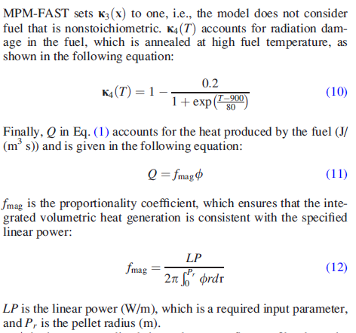
Heat Transport

Slide 17
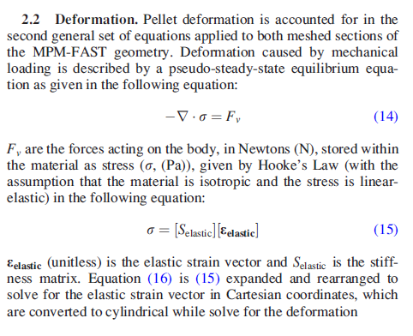
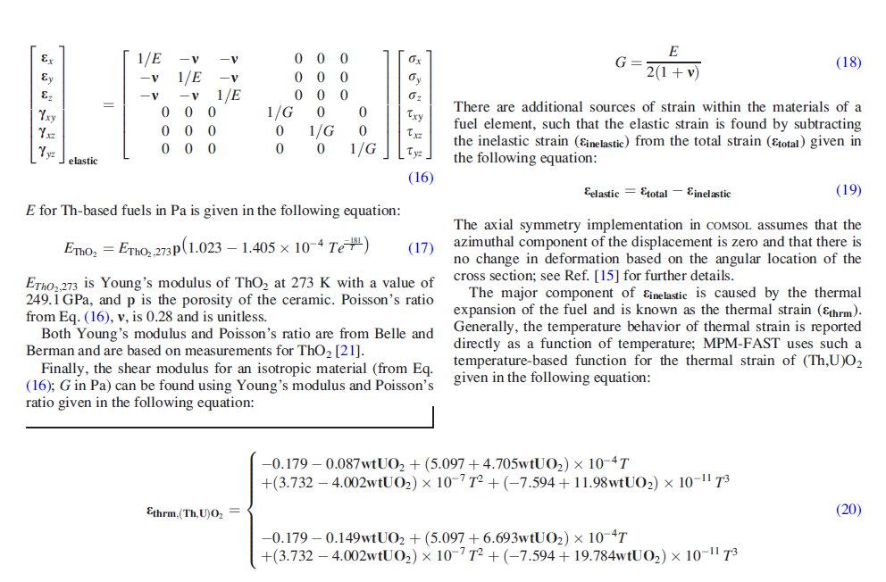
Deformation

Slide 18
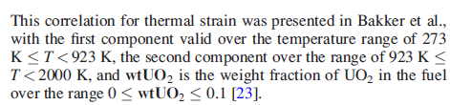
Deformation

Slide 19
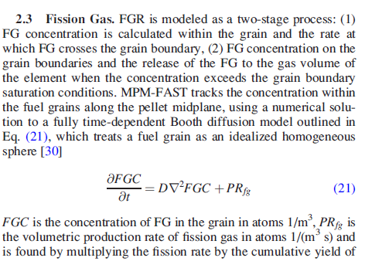
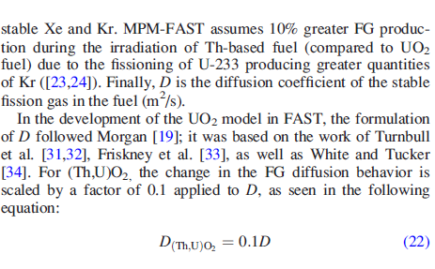
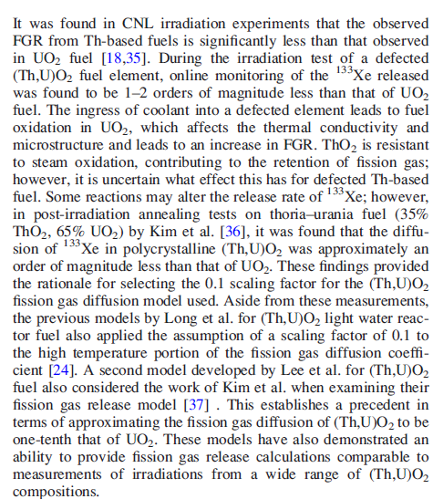
Fission Gas

Slide 20
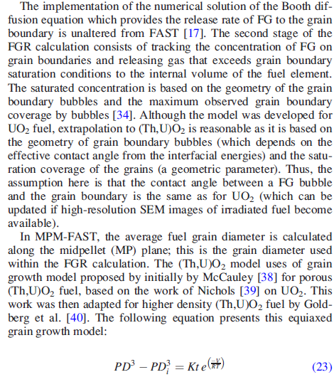
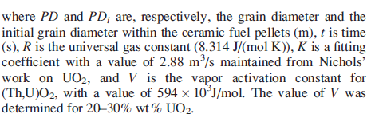
Fission Gas

